Slide 1

2015 Flight Delays and Cancellations
By Vertulie Pierre Louis

Slide 2
Introduction
In 2015 there were lots of flight delays in the United States. The U.S. Department of Transportation’s (DOT) Bureau of Transportation Statistics tracks the status of the flights by providing a summary of the arrival delays, departure delays, scheduled departure, on-time arrival in their monthly report. The data is acquired from Kaggle:https://www.kaggle.com/usdot/flight-delays. The flight data set contains 5819079 rows with 31 columns and 14 different carriers.
Gathering Data
For this project, I developed a model to predict how long a flight will be delayed at the Destination Airport. I created a Data set that can be used for both visualization and Model Building. The purpose of the visualization is to get a better inference of the data.
For the Split test, I have separated the Dataset into training and Testing Data so that prediction can be done on the testing Data. I also import Tableau that can make the visualization more feasible.
The technical aspect used is visualization: matplolib, seaborn. Including data manipulation: pandas, NumPy, modeling -sklearn: Linear Regression, Random Forest, & Decision tree.

Slide 3
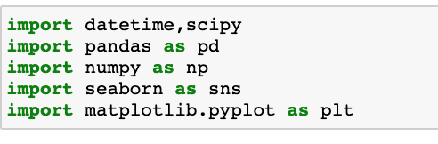


Importing Data

Slide 4

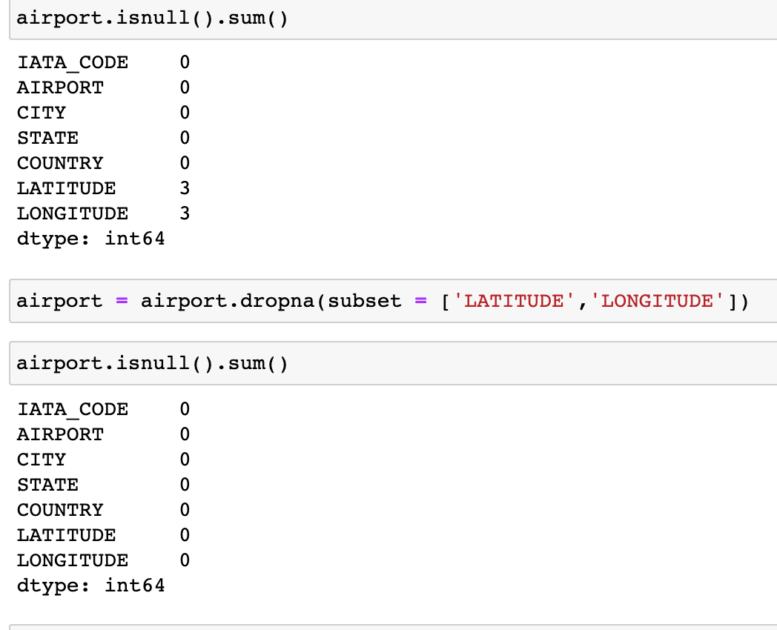
2015 Flig Delays and Cancellations
Data Collection & Wrangling Summary
The dataset consists of 5819079 rows and 31. When I take a closer look at the data, I noticed that several features have Null values.
I performed data wrangling by Renaming, Sorting reordering, duplicating data, Addressing missing or invalid data, and Filtering to the desired subset of data.
I used the IsNull() function to detect missing values. And The dropna() function to remove missing values.

Slide 5
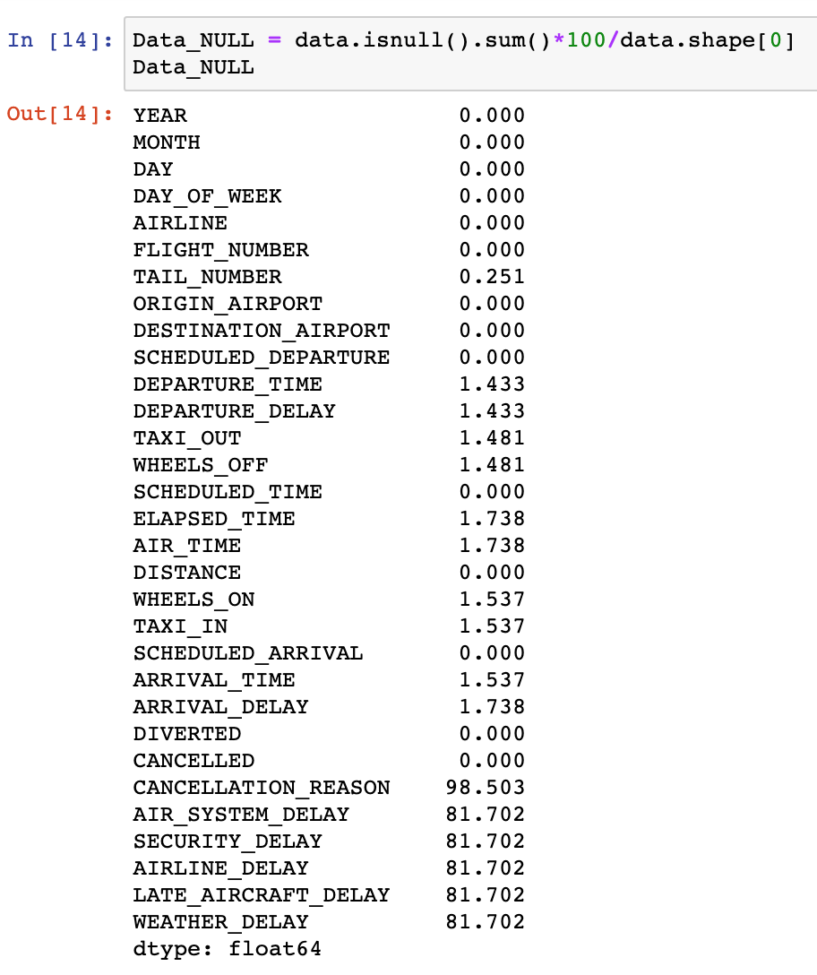
Data Collection/ Wrangling Summary
We can see that 98% of the values in the Cancellation reason column are null for which is of less use while predicting Delays. Some other columns include 81.7% in Air System Delay, Security Delay, Airline Delay, Weather Delay, etc. So I am going to create two Datasets that have no null values. First, I am removing all the null values irrespective of different types of Delays. Second, I am going to take the data set concerning different types of delays. The first Dataset is named Flights and the other one is named Flight_Delays.

Slide 6
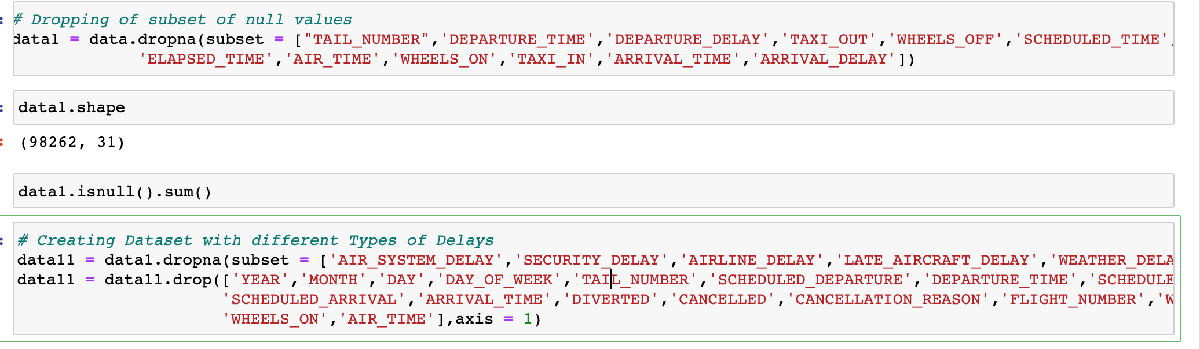
Data Collection/ Wrangling summary

Slide 7
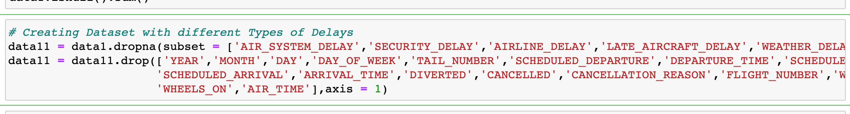
Data collection and wrangling summary
Dropna() Function
The dropna() function is used to remove missing values.

Slide 8
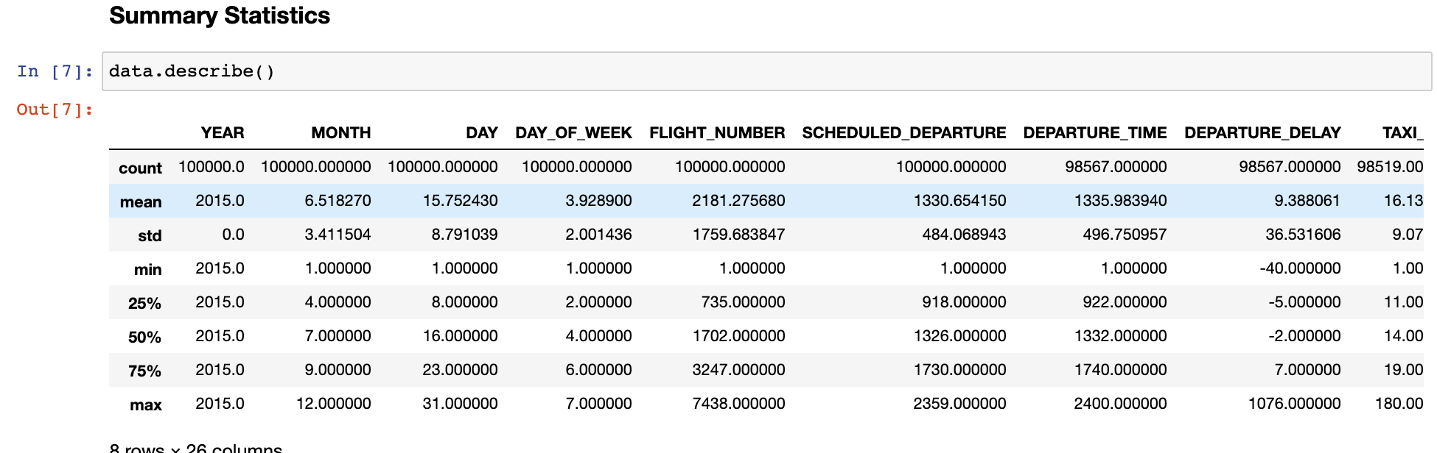
Exploratory data analysis summary (visualization and inferential statistics)
Exploratory Data Analysis refers to the critical process of performing initial investigations on data to discover patterns, to spot anomalies, to test hypotheses, and to check assumptions with the help of summary statistics and graphical representations.
For the Exploratory Data Analysis, I used Python coding and Tableau Visualization to get a brief insight and inference from the data.
I created various Plots so I can visualize the Dataset. And to get a glance at the variable affecting the delays of the Airlines.
I used describe() function is used to generate descriptive statistics that summarize the central tendency, dispersion, and shape of a dataset’s distribution, excluding NaN values.

Slide 9
Exploratory Data Analysis Summary (Visualization and Inferential Statistics)
Departure_Delay is the labeled variable. It plays a significant part in terms of explaining the answer to the project question.
The other subgroups /variables that are significant to the project are :
AIR_SYSTEM_DELAY, SECURITY_DELAY', AIRLINE_DELAY, LATE_AIRCRAFT_DELAY, WEATHER_DELAY, YEAR, MONTH, DAY, DAY_OF_WEEK, TAIL_NUMBER, SCHEDULED_DEPARTURE, DEPARTURE_TIME, SCHEDULED_TIME, SCHEDULED_ARRIVAL, ARRIVAL_TIME, DIVERTED, CANCELLED, CANCELLATION_REASON, 'FLIGHT_NUMBER, WHEELS_OFF, WHEELS_ON, AIR_TIME
From the Pearson correlation coefficient, I noticed that there is a strong correlation between Distance and Air_Time; Distance & Elapse_Time; Distance & Time_Scheduled; Schedule_Time & Air_time; Schedule Time & Distance, Departure_Delay & Departure_Delay, etc.
The most appropriate test to use to analyze these relations is the p-value testing.

Slide 10
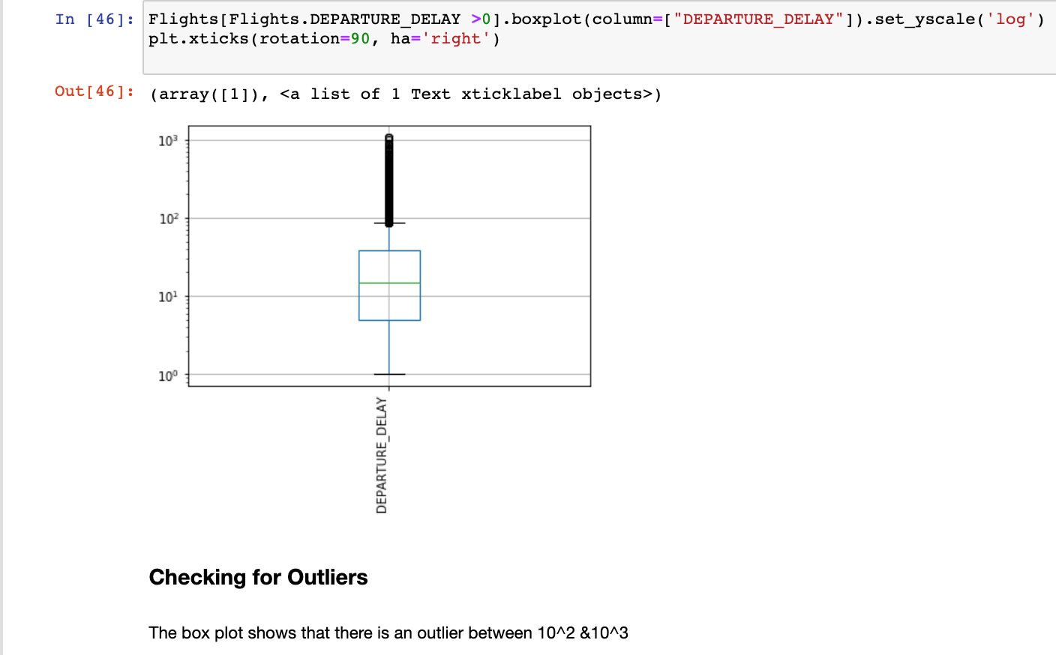
Exploratory data analysis summary (visualization and inferential statistics)

Slide 11
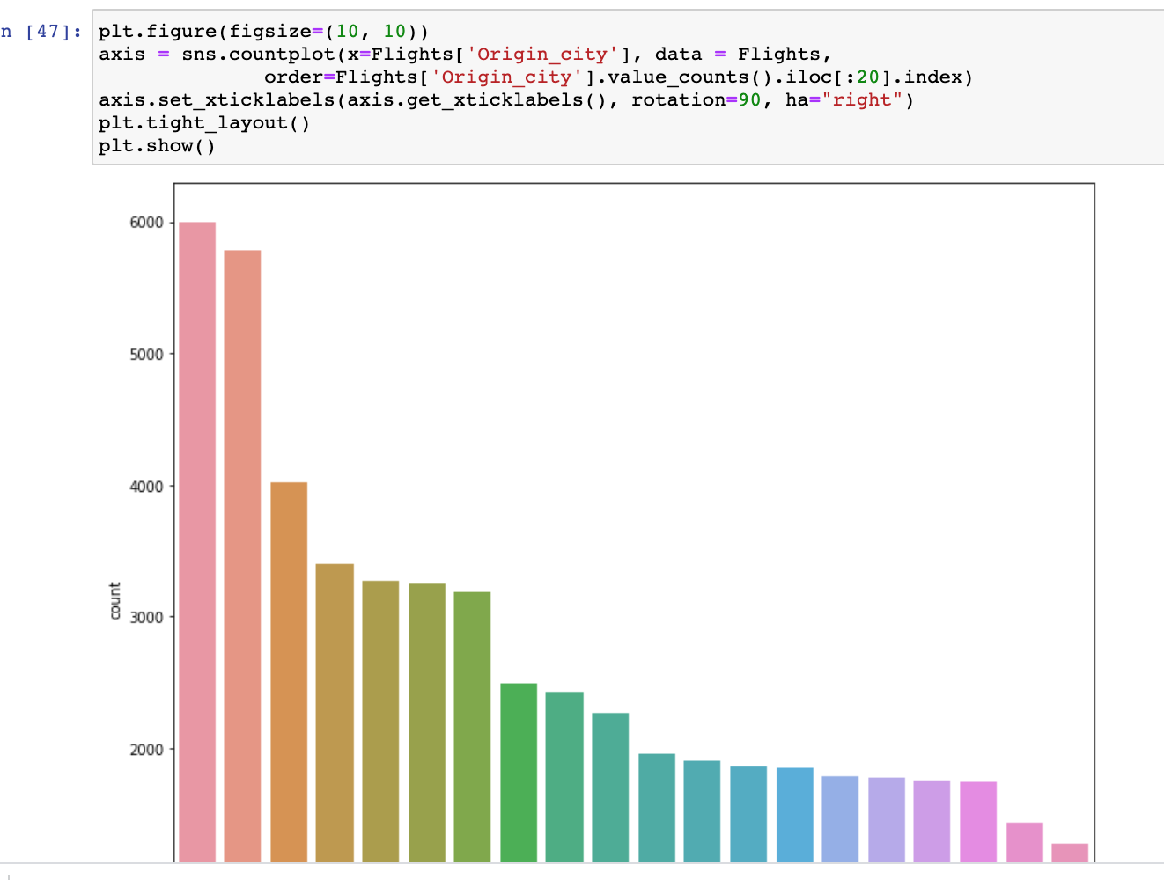
Exploratory data analysis summary (visualization and inferential statistics)
The count plot depicts the origin city on the x-axis and the departure delay on the y-axis. The count plot also shows that Chicago has the highest count of flight from origin city, follows by Atlanta.

Slide 12
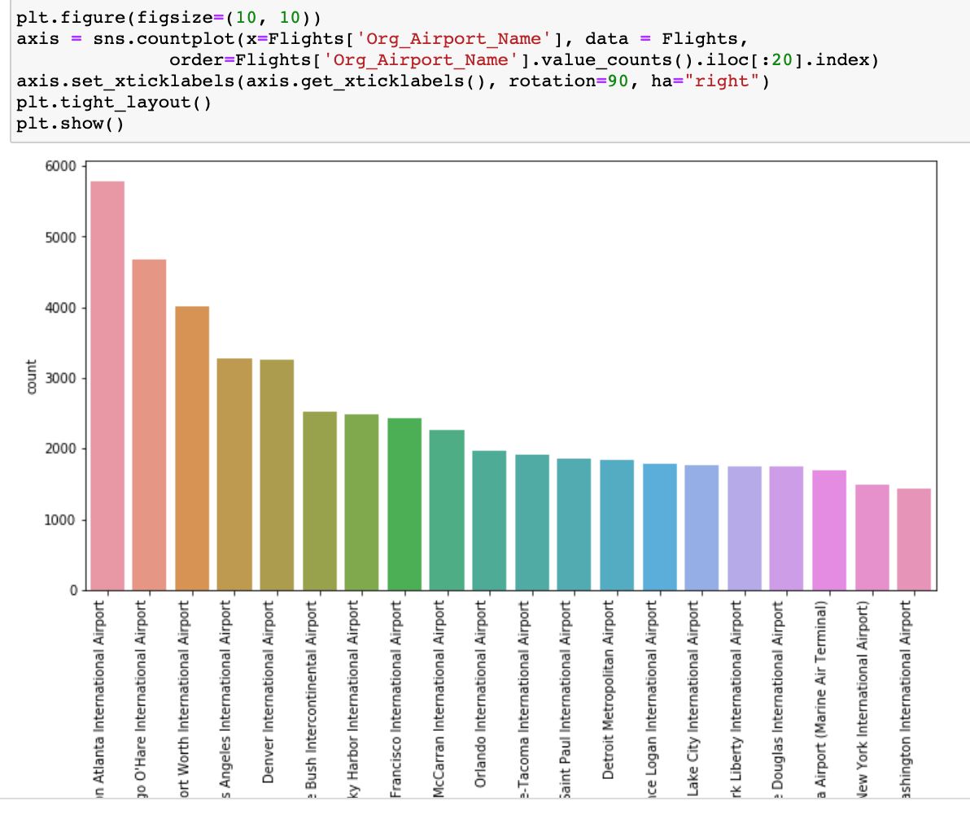
Exploratory Data Analysis Summary (visualization and inferential statistics)

Slide 13
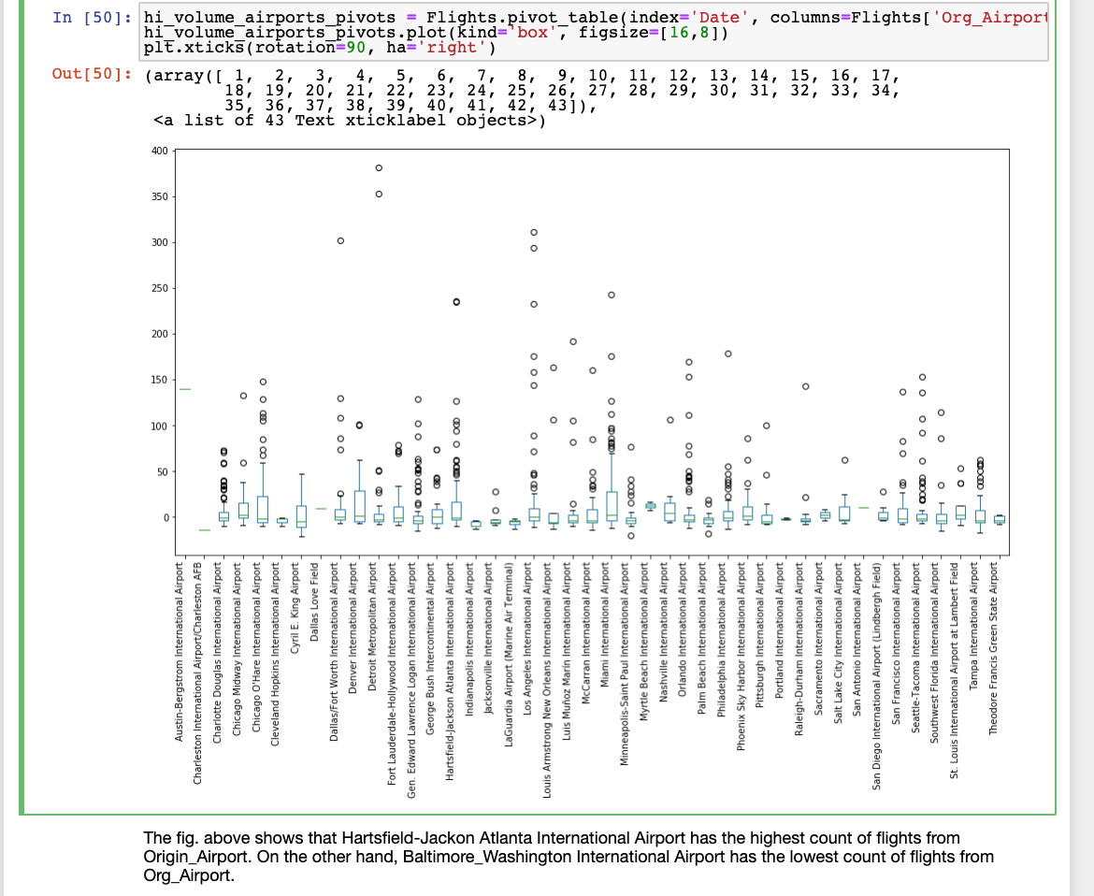

Slide 14
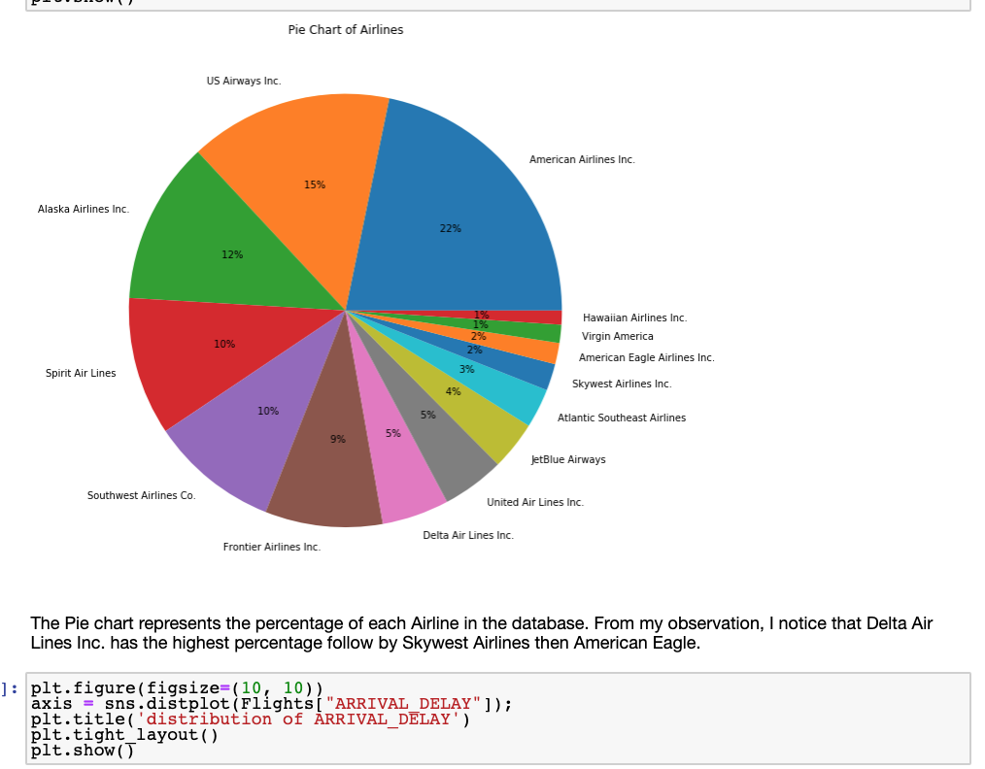
Exploratory data analysis summary (visualization and inferential statistics)
The Pie chart represents the percentage of each Airline in the database. From my observation, I notice that Delta Air Lines Inc. has the highest percentage follow by Skywest Airlines then American Eagle.

Slide 15
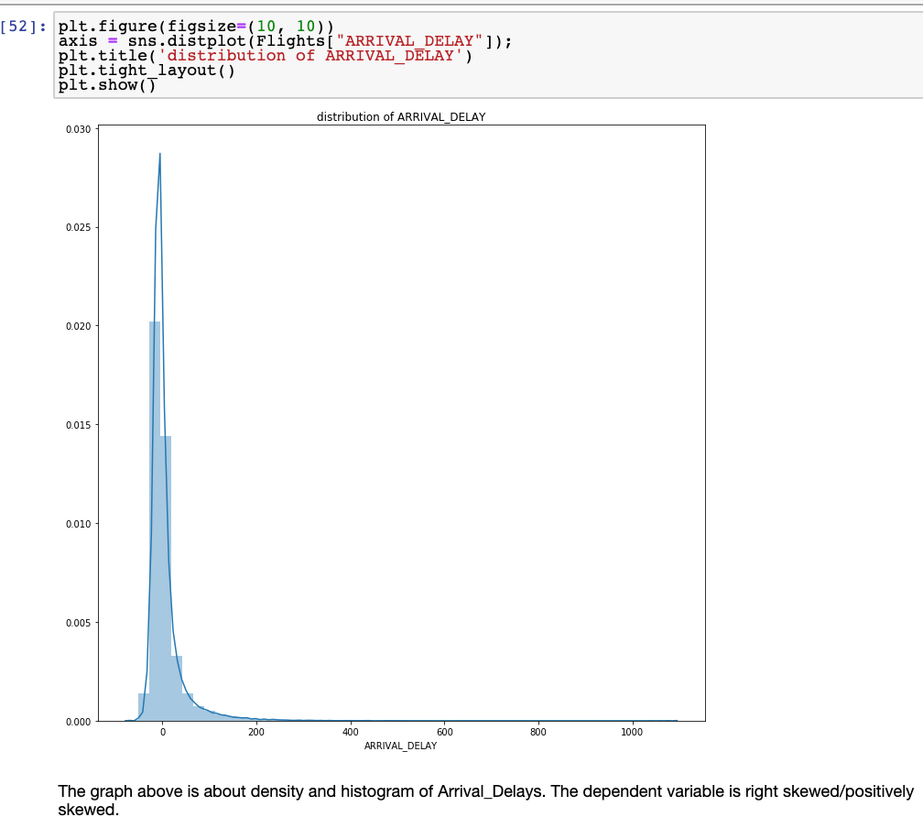
Exploratory data analysis summary (Visualization and Inferential Statistics)

Slide 16
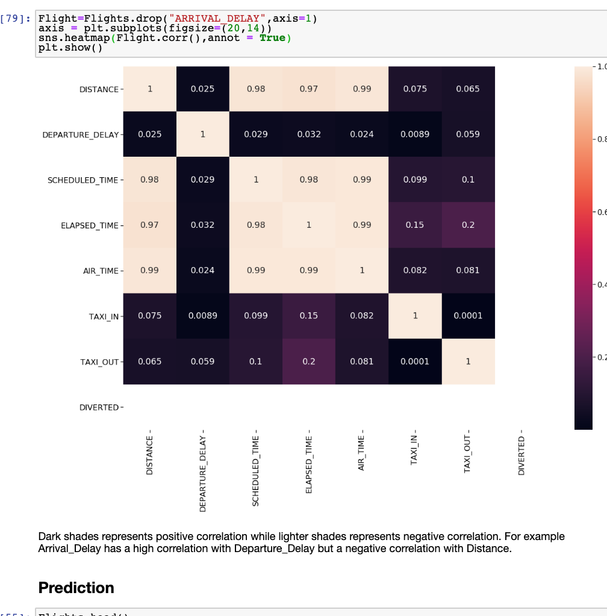
CO
Correlation

Slide 17
Prediction
I use 100000 samples to predict how much a flight will delay. Before applying machine learning, I performed One-hot coding to convert the categorical values into numerical values.
For the prediction, I separated the dataset into training and testing. Training data helps recognize patterns in the dataset. And Testing data is used to evaluate the performance of the model.
Also, From sci-kit-learn, I used Linear regression, Random forest, and Decision Tree for model comparison.
I also used scaling, a method used to normalize the range of independent variables or features of data.
To determine the optimal values and accuracy of the model, I used Grid Search and cross-validation

Slide 18
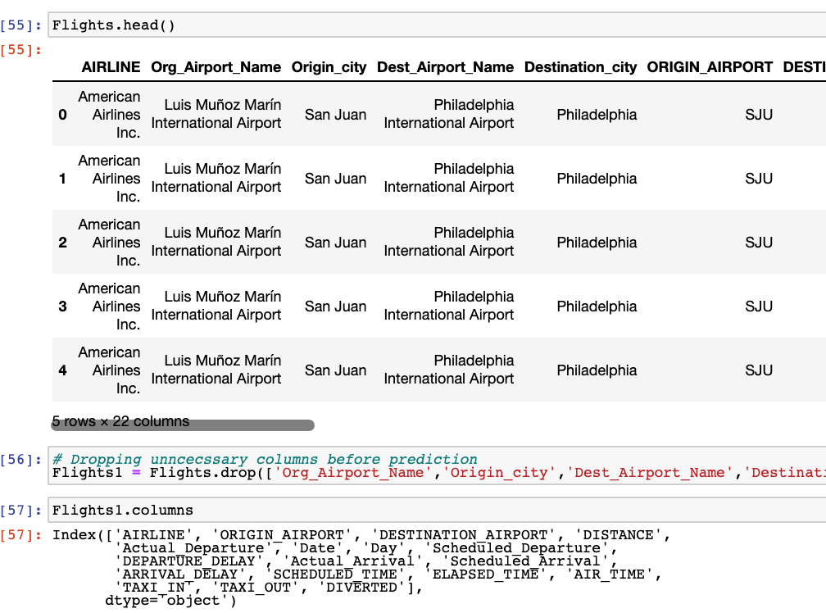
Prediction

Slide 19
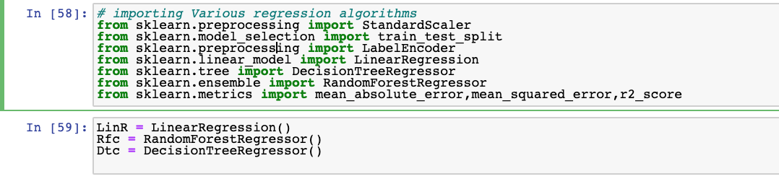
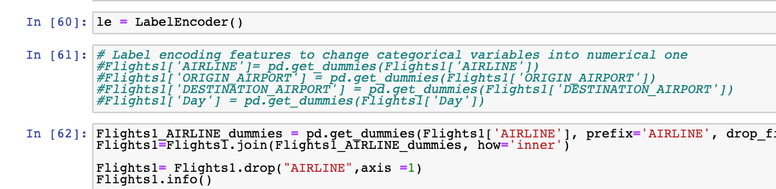
Prediction

Slide 20
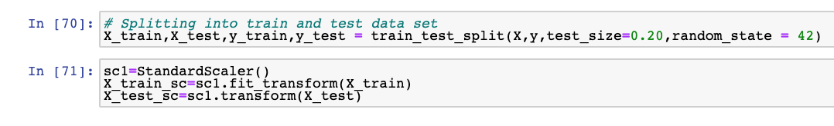
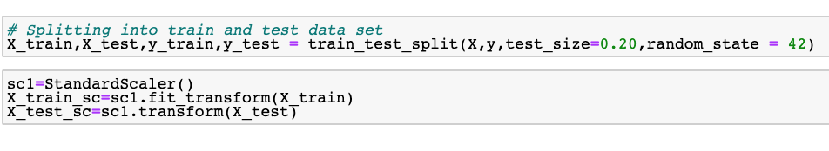
Model Fitting/Split Test

Slide 21
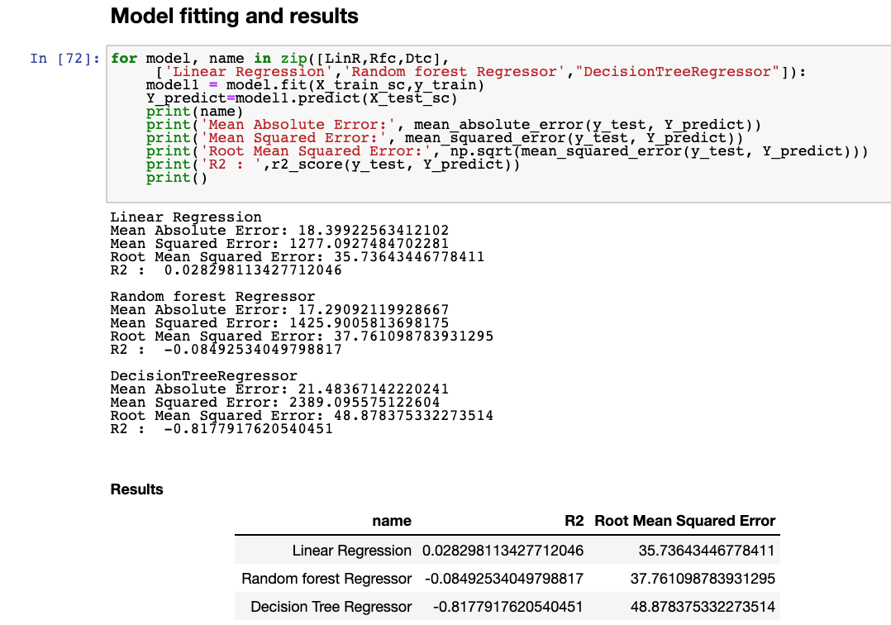

Slide 22
Advantage/Disadvantage(s)
Advantage:
Linear Regression is that it helps to find the relationships between independent and dependent variables.
Disadvantage:
Linear regression only looks at linear relationships between dependent and independent variables.
Advantage
decision tree can handle both numerical and categorical data. And it is extremely fast to run.
Disadvantage
The model is prone to overfitting, especially when a tree is particularly deep.
Advantages:
1)Random Forest has the ability to handle multiple input features without the need for features deletion.
2. Random Forest Works well with missing data. Ant it still gives better predictive accuracy.
Disadvantage:
Random Forest is Not easily interpretable

Slide 23
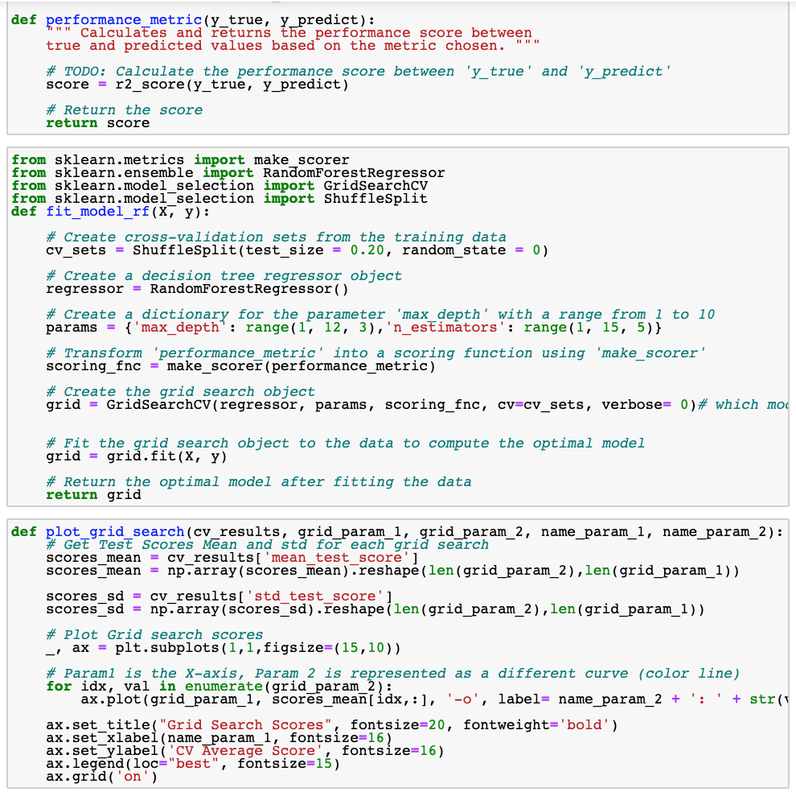

Slide 24
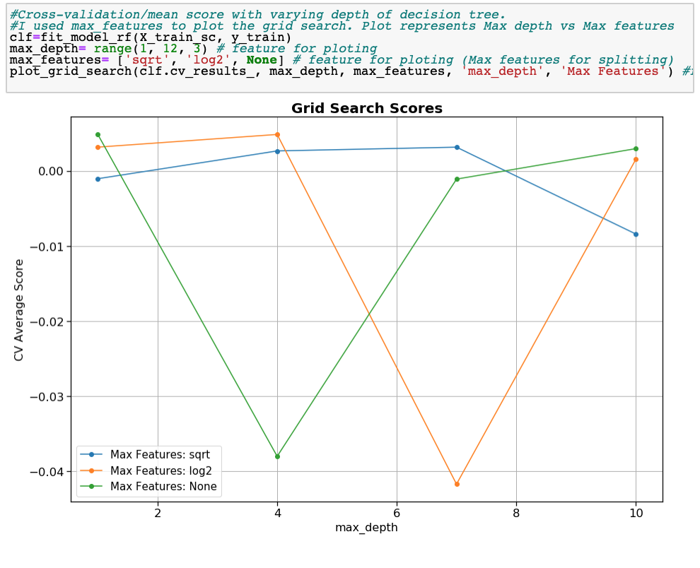

Slide 25
Discussion/Results
The models did not work. I only compared three models: Linear Regression, Random Forest, and Decision Tree. For future reference, I would use more models to make my comparison. I can also try some deep learning techniques.

